Slide 1



Building an Image Caption Generator using CNN-LSTM from Scratch
2021/E/015
2021/E/123
2021/E/189
01

Slide 2
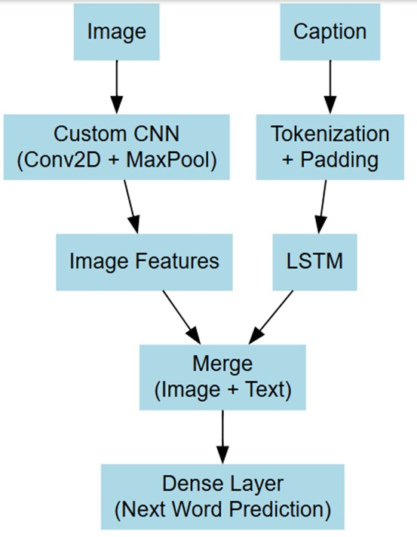
Model Architecture
CUSTOM CNN-IMAGE FEACTURE EXTRACTION
LSTM-GENERATING CAPTION
02

Slide 3
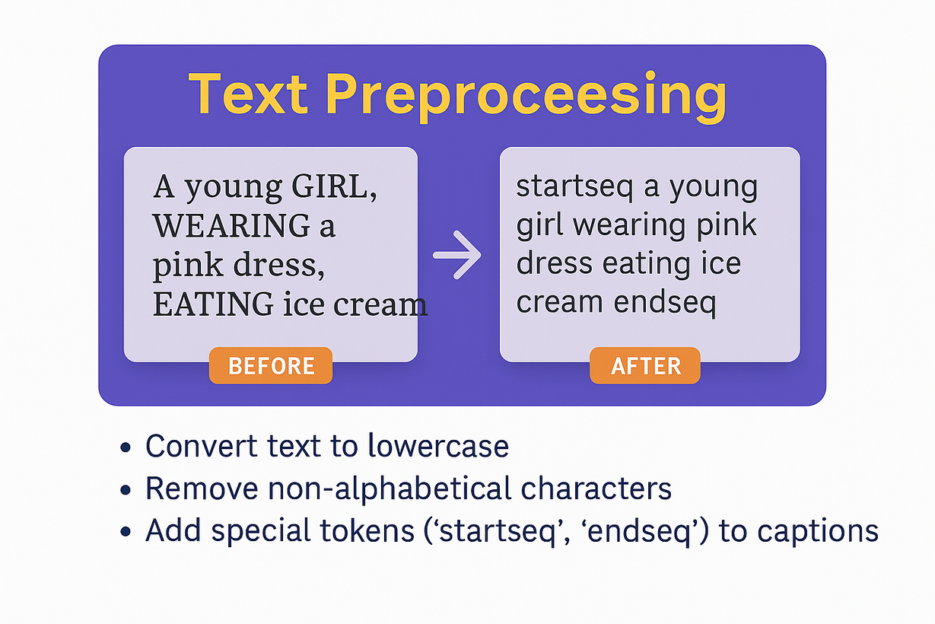
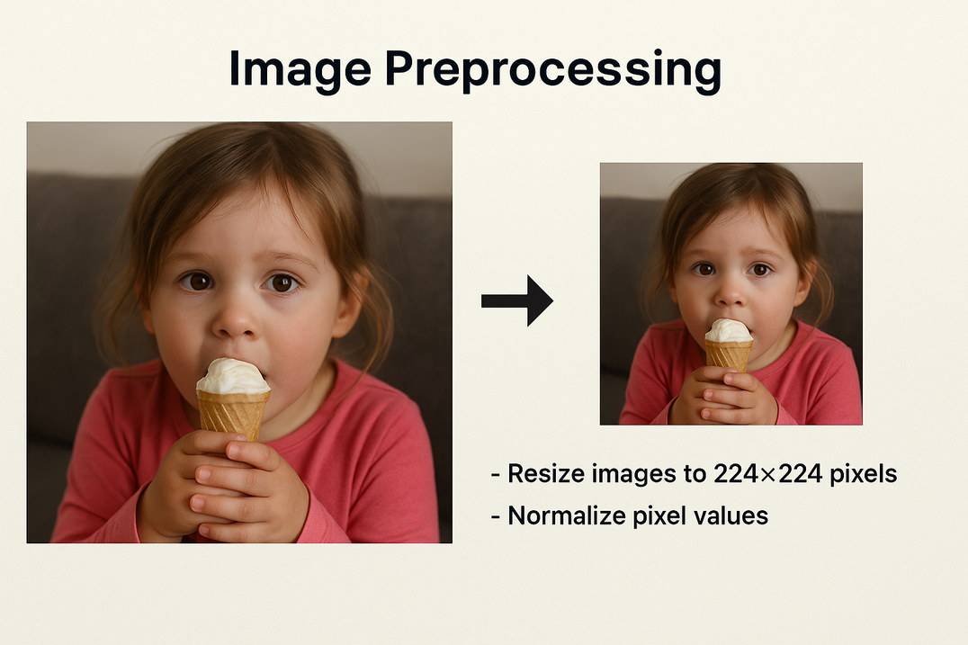
Data Preprocessing Methodology
Dataset: Flickr8k (8,090 images, 5 captions each)

Slide 4
Training Setup
Optimizer: Adam
Loss Function: Categorical cross-entropy
Techniques Used:
Early stopping
Model checkpointing
Learning rate reduction

Slide 5
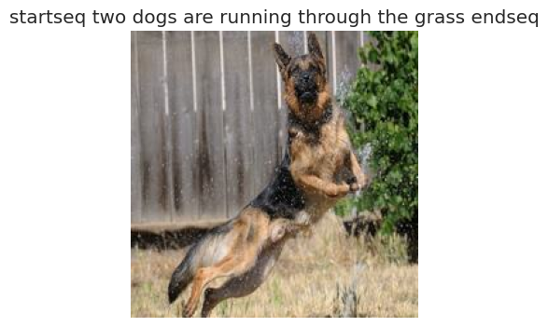
Evaluation & Results
BLEU Score: 0.7618

Slide 6
Conclusion
CNN-LSTM-based Image Caption Generator successfully implemented.
Performs well in generating image captions.
Needs further enhancements for improved performance:
Incorporate attention mechanisms.
Explore large datasets like Flickr30k and MS COCO.

Slide 7
Thank you

